Slide 1
Usability Testing Report Insights
Prepared by:
Ismail Abdul Maroof

Slide 2



Report | Table of Contents
Dataset Overview
Data, Charts & Interpretation
Problem identification & Conclusion

Slide 3
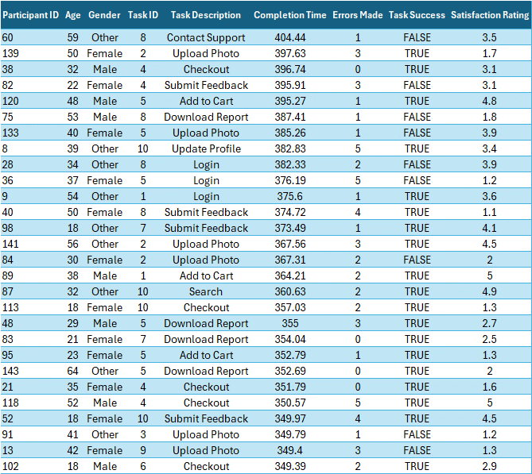

Dataset Overview
Data Snapshot
Tool Used:
Excel
Chatgpt
PowerPoint
Data Characteristics
Total rows = 150
Total Columns = 9
Total data without Heading = 1,350
Total “Number” columns = 6
Total “Text” columns = 3
Basic Statistical operations on number columns

Slide 4
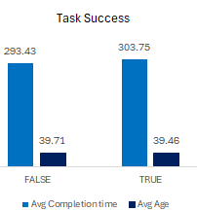
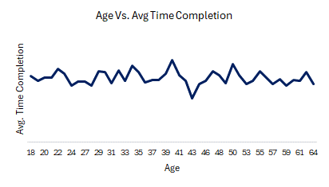
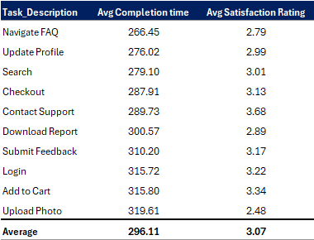
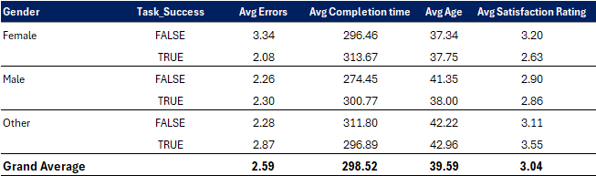
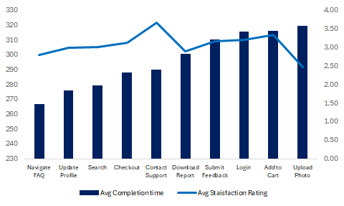
Data, Charts & Interpretation
There is low correlation between average completion time and average satisfaction rating.
Correlation = 0.027
Age and Gender have no significant effect on the performance of tasks

Slide 5
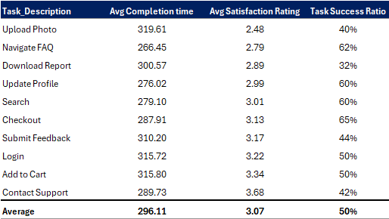
Problem identification & Conclusion
Tasks with lowest satisfactory rating than average
Conclusions
“Upload Photo” and “Download Report” have one of the lowest satisfactory rating and task success ratio.
Tasks such as “Login”, “Add to Cart”, and “Contact Support” have one of the highest satisfactory rating but one of the lowest success ratio. Therefore, this need to be investigated.

Slide 6
Thank You

